Slide 1
ATM
© Jörg Liebeherr, 1998-2003

Slide 2
Topics
Introduction
ATM Architecture Overview
ATM Cell
ATM Connections
Addressing and Signaling
ATM Layer Services
IP over ATM
© Jörg Liebeherr, 1998-2003

Slide 3
Introduction
© Jörg Liebeherr, 1998-2003

Slide 4
Broadband Integrated Services Networks
In the mid-1980s, the ITU-T (formerly CCITT) initiated a standardization effort to merge voice, video and data on a single network
The goal was to replace all existing networks (telephony networks, Cable TV network, data networks) with a single network infrastructure. The effort was called B-ISDN (Broadband Integrated Services Digital Networks)
The technology selected for B-ISDN was Asynchronous Transfer Mode (ATM) and SONET/SDH (Synchronous Optical Network/Synchronous Digital Hierarchy)
© Jörg Liebeherr, 1998-2003

Slide 5
Traditional Network Infrastructure
Telephone network
Company
B
Company
A
Data network
Video network
Residential
user
x
© Jörg Liebeherr, 1998-2003

Slide 6
B-ISDN
Broadband
Integrated Services
Network
(B-ISDN)
Company
B
Company
A
Residential
user
x
© Jörg Liebeherr, 1998-2003

Slide 7
ATM: The official definition
CCITT Definition (I.113, Section 2.2)
  A transfer mode in which the information is organized into cells; it is asynchronous in the sense that the recurrence of cells containing information from a particular user is not necessarily periodic
© Jörg Liebeherr, 1998-2003

Slide 8
Why “asynchronous”?
Synchronous transfer mode (= Time division multiplexing)
  Each source gets period assignment of bandwidth
    good: fixed delays, no overhead
    bad: poor utilization for bursty sources
Asynchronous transfer mode (= Statistical multiplexing)
  Sources packetize data. Packets are sent only if there is data
    good: no bandwidth use when source is idle
    bad: packet headers, buffering, multiplexing delay
1
2
3
4
1
2
3
4
1
2
3
4
1
2
3
4
1
2
3
4
1
2
3
4
1
2
3
4
H
1
H
3
H
3
H
2
H
1
H
4
© Jörg Liebeherr, 1998-2003

Slide 9
ATM’s Key Concepts
ATM uses Virtual-Circuit Packet Switching
  ATM can reserve capacity for a virtual circuit. This is useful for voice and video, which require a minimum level of service
  Overhead for setting up a connection is expensive if data transmission is short (e.g., web browsing)
ATM packets are small and have a fixed sized
  Packets in ATM are called cells
  Small packets are good for voice and video transmissions
Header
(5 byte)
Data (48 byte)
Cell is 53 byte long
© Jörg Liebeherr, 1998-2003

Slide 10
53 Byte Cells
Why 53 Bytes?
A 48 byte payload was the result of a compromise between a 32 byte payload and a 64 byte payload
Advantages
  Low packetization delay for continuous bit rate applications (video, audio)
  Processing at switches is easier
Disadvantages
  High overhead (5 Bytes per 48)
  Poor utilization at lower line rates links
© Jörg Liebeherr, 1998-2003

Slide 11
ATM Standardization
Until 1991, standardization occurred within CCITT (now: ITU-T) in a series of recommendations in the I series
In 1991, ATM Forum was formed as an industry consortium
    ATM Forum starts to prepare specifications to accelerate the definition of ATM.
    Specifications are passed to ITU-T for approval
    Since 1993, ATM Forum drives the standardization process
IETF publishes Request for Comments (RFCs) that relate to IP/ATM issues
© Jörg Liebeherr, 1998-2003

Slide 12
Uses of ATM
1985
1990
1995
2000
B-ISDN vision
Internet vision
ATM on the desktop
Fast Ethernet
IP-over- ATM
MPLS
(in core)
ATM Enterprise backbones
GigEthernet
HFC networks
DOCSIS
Special purpose applications with QoS demands
Access Networks (xDSL)
Frame Relay transport
Voice trunking
© Jörg Liebeherr, 1998-2003

Slide 13
ATM Architecture
Overview
© Jörg Liebeherr, 1998-2003

Slide 14
The ATM Reference Model
ATM technology has its own protocol architecture
Control Plane
User Plane
Upper Layer
Upper Layer
End-to-end layer
ATM Adaptation Layer (AAL)
Transfer of Cells
ATM Layer
Physical Layer
Transmission of Bits
© Jörg Liebeherr, 1998-2003

Slide 15
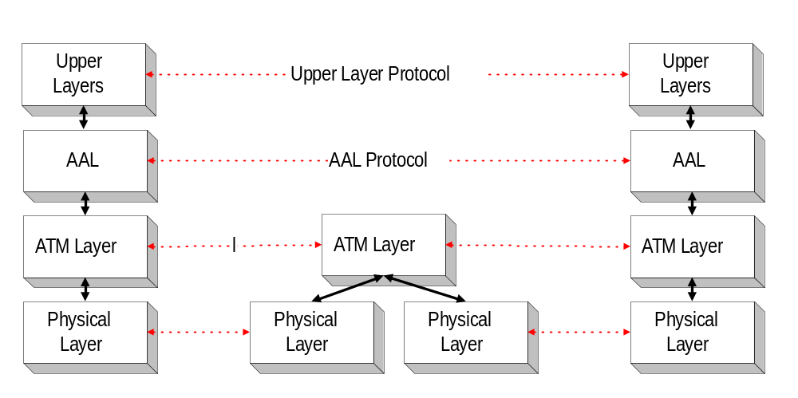
Layers of ATM
Host A
ATM
Switch
Host B
© Jörg Liebeherr, 1998-2003

Slide 16
Function of the Layers
Convergence
AAL
Segmentation and Reassembly
Generic Flow Control
Cell VPI/VCI translation
Cell multiplexing and demultiplexing
Cell header generation and extraction
ATM
HEC header sequence
generation and verification
Cell delineation
Transmission frame
generation and recovery
TC
Physical
Bit timing
Physical medium
PM
TC: transmission convergence
PM Physical medium
© Jörg Liebeherr, 1998-2003

Slide 17
ATM Layer
The ATM Layer is responsible for the transport of 53 byte cells across an ATM network
Multiplex logical channels within a physical channel
© Jörg Liebeherr, 1998-2003

Slide 18
ATM Layer
The ATM Layer can provide a variety of services for cells from an ATM virtual connection:
    Constant Bit Rate (CBR)
      guarantees a fixed capacity, similar to circuit switching
      guarantees a maximum delay for cells
    Variable Bit Rate (VBR)
      guarantees an average throughput and maximum delay
    Available Bit Rate (ABR)
      guarantees ‘fairness” with respect to other traffic
    Unspecified Bit Rate (UBR)
      service is on a “best effort” basis
    Guarantees Frame Rate (GFR)
      Throughput guarantee for multiple cell frames
© Jörg Liebeherr, 1998-2003

Slide 19
ATM Adaptation Layer (AAL)
AAL encapsulates user-level data
Performs segmentation and reassembly of user-level messages
Data
Data
AAL
AAL
segmentation
reassembly
ATM Network
Cells
Cells
© Jörg Liebeherr, 1998-2003

Slide 20
ATM Cells
© Jörg Liebeherr, 1998-2003

Slide 21
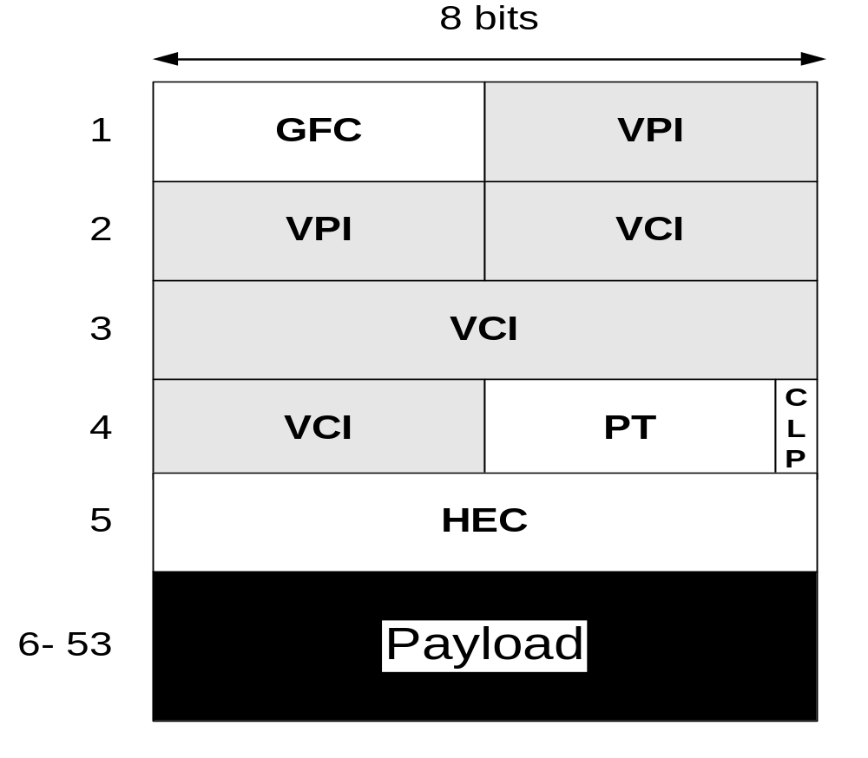
ATM Cells
4-bit Generic flow control
8/12 bit Virtual Path Identifier
16 bit Virtual Channel Identifier
3 bit Payload Type
1 bit Cell Loss Priority
8 bit Header Error Control
48 byte payload
GFC field only in UNI cells
UNI Cell
© Jörg Liebeherr, 1998-2003

Slide 22
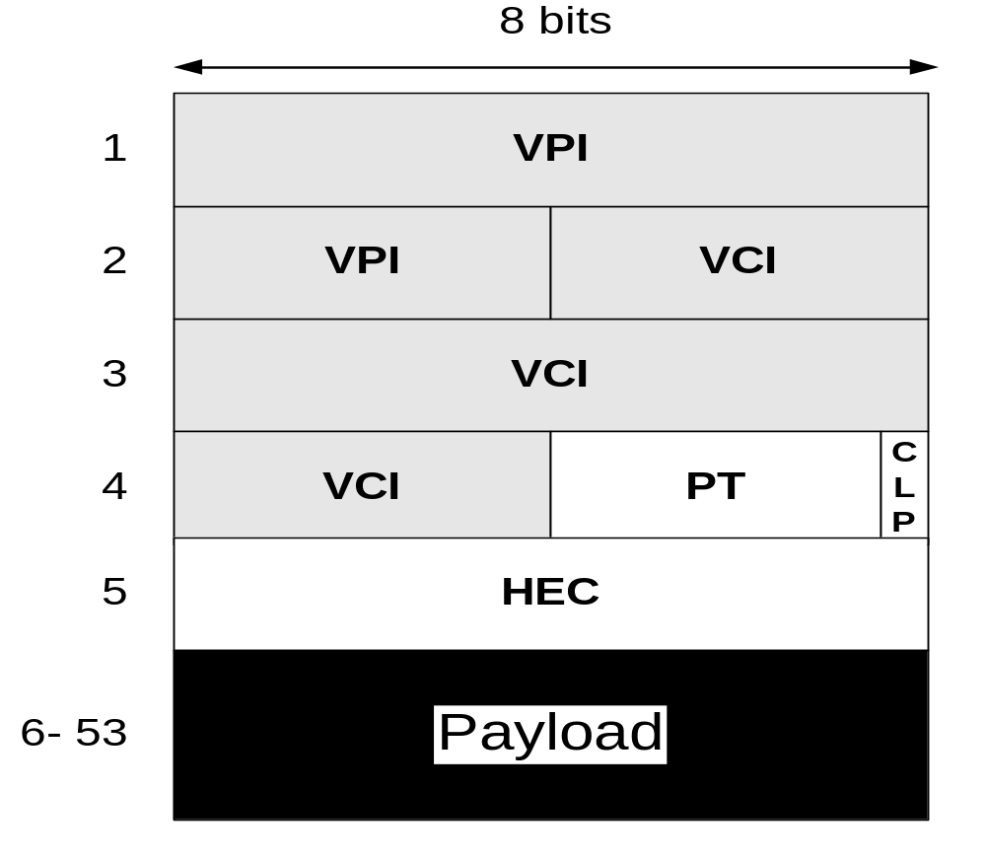
ATM Cells
4-bit Generic flow control
8/12 bit Virtual Path Identifier
16 bit Virtual Channel Identifier
3 bit Payload Type
1 bit Cell Loss Priority
8 bit Header Error Control
48 byte payload
At NNI: GFC byte is used for additional VPI
NNI Cell
© Jörg Liebeherr, 1998-2003

Slide 23
ATM Connections
© Jörg Liebeherr, 1998-2003

Slide 24
A Packet Switch
Header
Data
Packet
Packet switch
© Jörg Liebeherr, 1998-2003

Slide 25
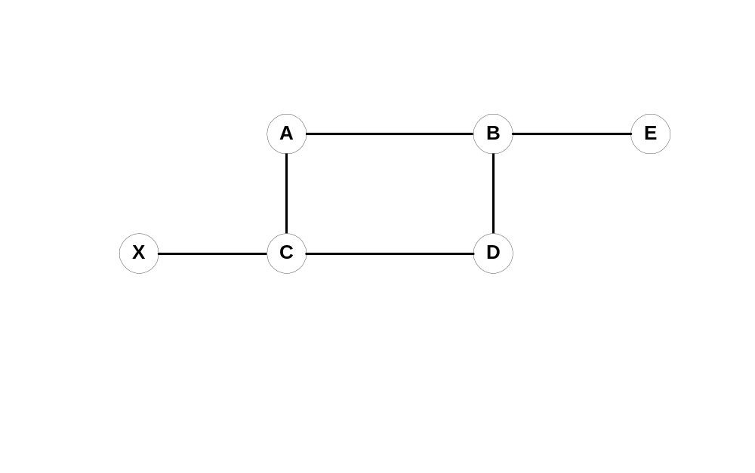
Forwarding with VCs
Part 1: VC setup from X to E
n_{in} | V_{in} | n_{out} | V_{out}
D | 5 | E | 3
n_{in} | V_{in} | n_{out} | V_{out}
- | - | C | 5
n_{in} | V_{in} | n_{out} | V_{out}
B | 3 | - | -
n_{in} | V_{in} | n_{out} | V_{out}
X | 5 | D | 3
n_{in} | V_{in} | n_{out} | V_{out}
C | 3 | B | 5
© Jörg Liebeherr, 1998-2003

Slide 26
Forwarding with VCs
Part 2: Forwarding the packet
n_{in} | V_{in} | n_{out} | V_{out}
D | 5 | E | 2
2
n_{in} | V_{in} | n_{out} | V_{out}
- | - | C | 5
5
n_{in} | V_{in} | n_{out} | V_{out}
B | 3 | - | -
5
3
n_{in} | V_{in} | n_{out} | V_{out}
X | 5 | D | 3
n_{in} | V_{in} | n_{out} | V_{out}
C | 3 | B | 5
© Jörg Liebeherr, 1998-2003

Slide 27
Virtual Paths and Virtual Circuits
Link
Virtual
Channel
Connection
Virtual Path Connections
VPI identifies virtual path (8 or 12 bits)
VCI identifies virtual channel in a virtual path (16 bits)
© Jörg Liebeherr, 1998-2003

Slide 28
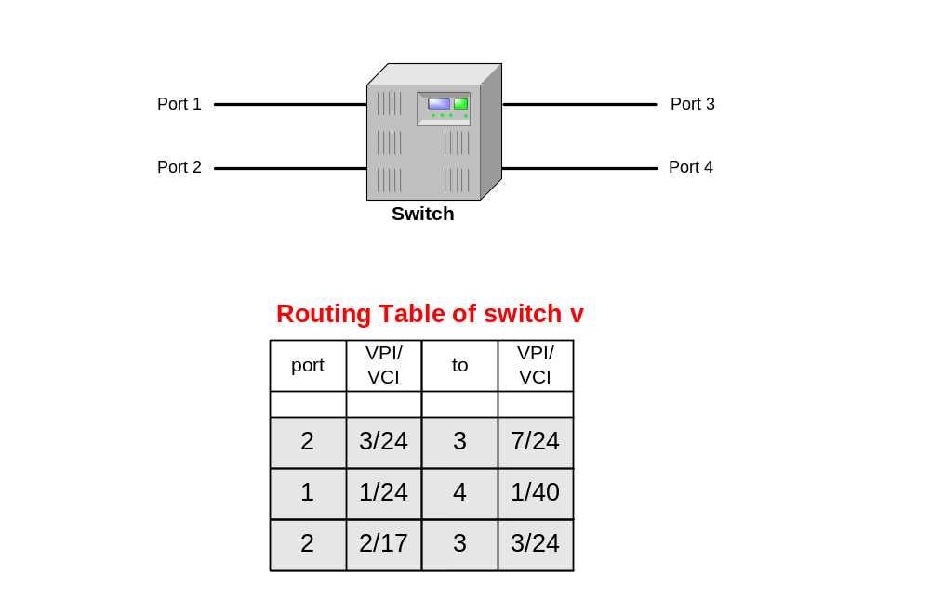
VPI/VCI assignment at ATM switches
1/24
3/24
7/24
2/17
3/24
1/40
© Jörg Liebeherr, 1998-2003

Slide 29
Addressing and Signaling
© Jörg Liebeherr, 1998-2003

Slide 30
ATM Endsystem Addresses (AESA)
All ATM addresses are 20 bytes long
Source and destination address are supplied when setting up a connection
ATM endpoints use the NSAP (Network Service Access Point) format from ISO OSI
Three different types of addresses
    NSAP encoding for E.164: ISDN telephone numbers
    (e.g., 001-434-9822200)
    DCC format: for public networks
    ICD format: for private networks
© Jörg Liebeherr, 1998-2003

Slide 31
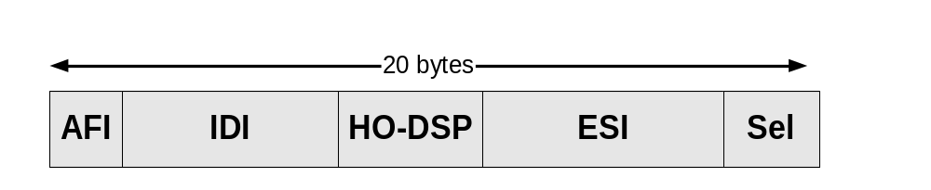
ATM Endsystem Addresses (AESA)
AFI (1 byte): Authority and Format Identifier
Tells which addressing scheme to use
IDI (2-8 bytes): Initial Domain Identifier
Identifies a domain within scope of addressing authority
HO-DSP (4-10 bytes): High-order bits of domain specific part
similar to network prefix of IP address
ESI (6 bytes): Endsystem identifier
similar to host number of IP address
SEL (1 byte): Selector
for endsystem use only
© Jörg Liebeherr, 1998-2003

Slide 32
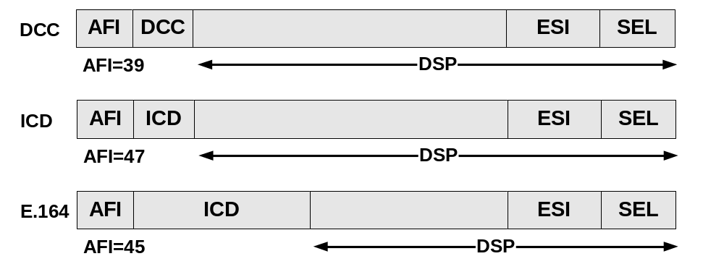
Formats of an ATM address
AFI: Authority and Format Identifier
DCC: Data Country Code
ICD: International Code Designator
E.164: ISDN (telephone) Number
IDI: Initial Domain Identifier
DSP: Domain Specific Part
ESI: Endsystem identifier
SEL: Selector
© Jörg Liebeherr, 1998-2003

Slide 33
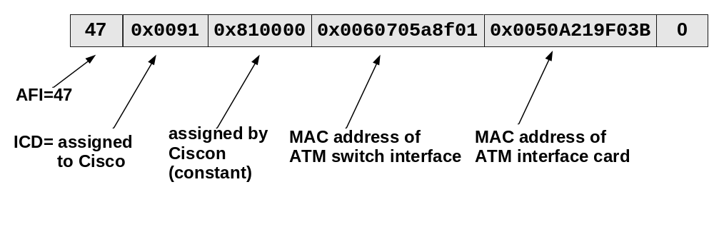
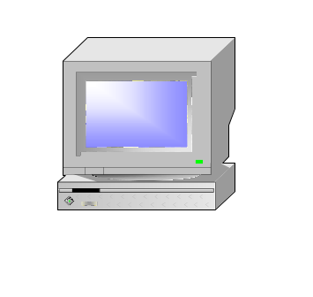

Example: Default Assignment of ATM addresses by Cisco Systems
47.00918100000001604799FD01.0050A219F03B.0
ATM switch
endsystem
© Jörg Liebeherr, 1998-2003

Slide 34
Which Address Format To Use?
Currently each service provider makes its own choice
  This introduces problems (SVC compatibility)
Most ATM switches support multiple formats
ATM Forum prepares standards to translate addresses at network boundaries (NNI interfaces)
  Interworking of ATM Networks (IAN)
© Jörg Liebeherr, 1998-2003

Slide 35
ATM UNI Signaling
Significant Signaling Protocols
ATM Forum:
UNI 3.0. UNI signaling protocol for point-to-point connections.
UNI 3.1. Supports point-to-multipoint connections.
UNI 4.0. Supports Leaf initiated join multipoint connections
PNNI. for network node signaling
The ATM Forum signaling specifications are based on the Q.2931 public network signaling protocol developed by the ITU-T.
  specifies a call control message format
    message type (setup, call proceeding, release)
    Addresses
    AAL parameters
    Quality of Service (QoS)
© Jörg Liebeherr, 1998-2003

Slide 36
Basic Signaling Exchange: Setup of a SVC
ATM
A
B
Setup to B
Setup to B
Call Proceeding
Call Proceeding
Connect
Connect
Connect ACK
Connect ACK
© Jörg Liebeherr, 1998-2003

Slide 37
Basic Signaling Exchange: Tear down
ATM
A
B
Release
Release
Release complete
Release complete
© Jörg Liebeherr, 1998-2003

Slide 38
6
ATM Layer Services
© Jörg Liebeherr, 1998-2003

Slide 39
ATM Services at the ATM Layer
The following ATM services have been defined:
Constant Bit Rate (CBR)
Real-time Variable Bit Rate (rt-VBR)
Non-real-time Variable Bit Rate (nrt-VBR)
Available Bit Rate (ABR)
Unspecified Bit Rate (UBR)
Guaranteed Frame Rate (GFR)
ABR and UBR
Usage of capacity
VBR
CBR
© Jörg Liebeherr, 1998-2003
Time

Slide 40
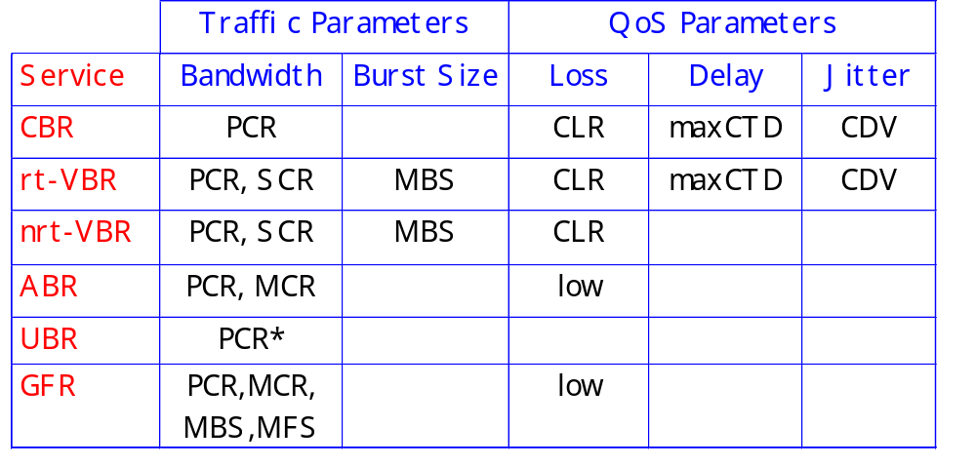
ATM Network Services
CDVT characterizes an interface and is not connection specific
PCR in UBR is not subject to CAC or UPC
© Jörg Liebeherr, 1998-2003

Slide 41
Constant Bit Rate (CBR)
For applications with constant rate requirements:
video and audio
Very sensitive to delay
and delay variations
Adaptation Layer: AAL1
rate
peak rate
time
© Jörg Liebeherr, 1998-2003

Slide 42
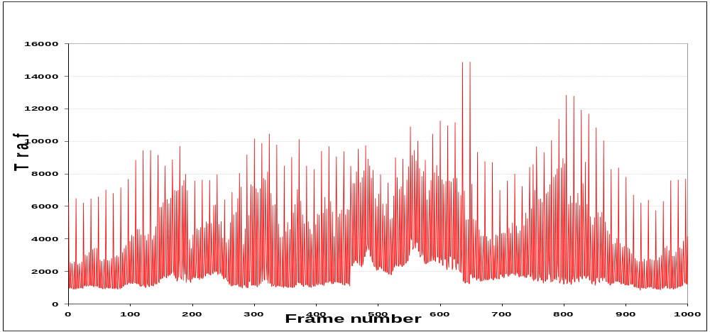
Variable Bit Rate (rt-VBR, nrt-VBR)
For applications with variable rate requirements:
compressed audio and video (rt-VBR)
data applications (nrt-VBR), such as transactions
Adaptation Layer: AAL2, AAL 3 /4, AAL5
Example: 30 sec MPEG-1 trace (from Terminator)
Peak rate: 1.9 Mbps
Avg. rate: 0.261 Mbps
© Jörg Liebeherr, 1998-2003

Slide 43
Available Bit Rate (ABR)
For applications that can tolerate changes to rate
Interconnection of LANs
Transmission rate (ACR) changes between MCR and PCR
ACR is set by a feedback algorithm (to be discussed)
Adaptation Layer: AAL 5
PCR
ACR
MCR
time
© Jörg Liebeherr, 1998-2003

Slide 44
Unspecified Bit Rate (UBR)
“Best effort service”
  No bandwidth, loss, or delay guarantees
  UBR gets the bandwidth that is not used by CBR, VBR, ABR
No UPC and no feedback
Applications: Non-critical data applications (file transfer, web access, etc.)
Adaptation Layer: AAL5
© Jörg Liebeherr, 1998-2003

Slide 45
Guaranteed Frame Rate (UBR)
For non-real-time applications which guarantee a minimum rate guarantee
Recognizes AAL5 boundaries
  Frame consists of multiple cells
  If a cell is dropped, remaining cells from that frame will be dropped as well
Minimum rate (MCR) is guaranteed by network, the rest (up to PCR) is delivered on a best effort basis.
Adaptation Layer: AAL5
© Jörg Liebeherr, 1998-2003

Slide 46
9
IP-over-ATM
© Jörg Liebeherr, 1998-2003

Slide 47
Classical IP over ATM
ATM network card is treated like an Ethernet card
ATM Network consists of multiple logical subnets
IP datagram is encapsulated and then passed to AAL5
UDP
TCP
IP
SNAP / 802.2 LLC
AAL 5
ATM Layer
Physical Layer
© Jörg Liebeherr, 1998-2003

Slide 48
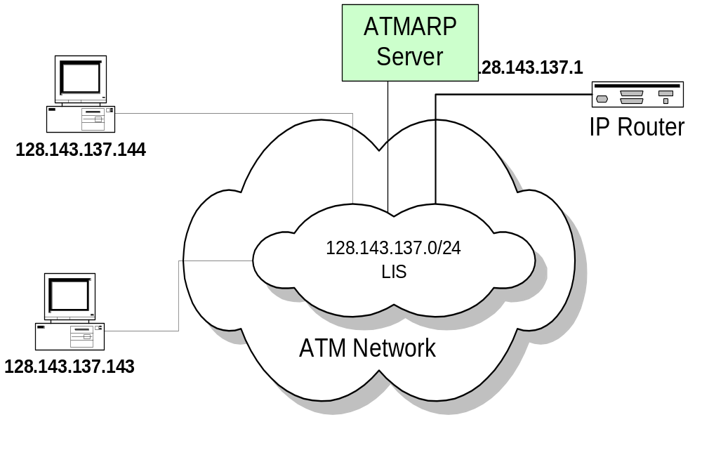
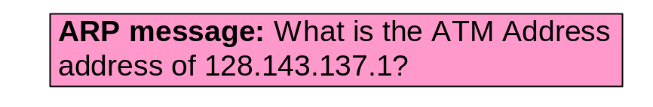
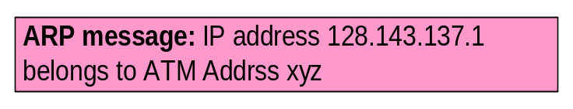
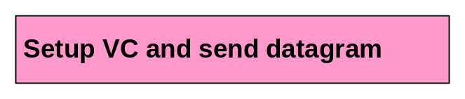
Logical IP Subnetwork (LIS)
Each host has a VC to the ATMARP server
  ATMARP translates between IP and ATM addresses
Each host connects to another host on the same LIS with a dedicated VC
IP datagrams to hosts on a different subnet are sent to router
© Jörg Liebeherr, 1998-2003

Slide 49
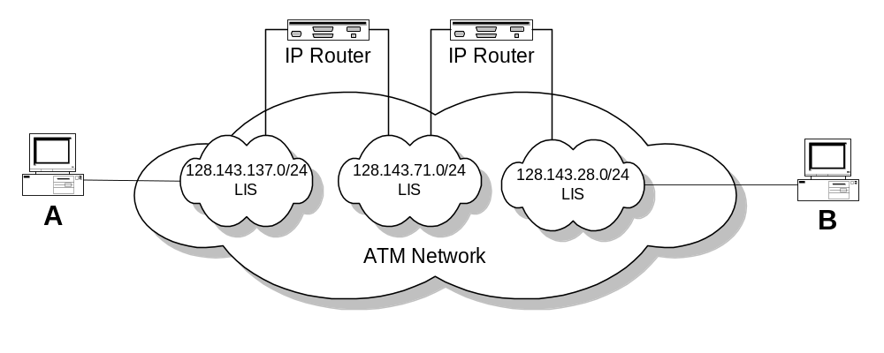
Problem with Classical IP-over-ATM
ATMARP server only resolve addresses for a single LIS
Traffic from A to B goes through two IP routers, even though both hosts are on the same ATM network
© Jörg Liebeherr, 1998-2003

